Slide 1
Halal Food Provider
In Ohio , USA

Slide 2
Introduction :
This project will be a study and comparison between two Counties ( Cuyahoga county and franklin county) to decide which area is better to start a business of Halal food provider
Why These two counties ?
These two counties are two major counties in Ohio
Franklin county :
As of 2019 census estimates, it is the most populous county in Ohio
Columbus (a city in the county) is the Ohio state capital
The most populous city in the U.S. state of Ohio
Cuyahoga county :
As of the 2019 United States Census estimates, it is the second most populous county in Ohio
Cleveland (a city in the county ) with an estimated 2019 population, is the second-largest city in Ohio as estimated in 2019
Information reference : https://en.wikipedia.org/

Slide 3
Roadmap to Analysis Goal

Slide 4
Collect data for both counties
Get the Cuyahoga county data including the Cities and zip codes using:
https://www.zipdatamaps.com/cuyahoga-oh-county-zipcodes
Get the Franklin county data including the Cities and zip codes using:
https://www.zipdatamaps.com/franklin-oh-county-zipcodes
Get the Geo by download the file from https://public.opendatasoft.com
Get the list of Avenues using Foursquare AP
Using clustering and segmentation
Find the Cluster of more frequency of Mediterranean restaurant or Halal stores for both Counties
Compare analysis to see which cluster has the most frequency of Mediterranean restaurant internally for each county
Compare analysis between the chosen cluster from Cuyahoga county and chosen cluster from Franklin county
Chose the cluster with more Mediterranean restaurant occurrence will be chosen the place to start the business

Slide 5
Download the dependences for the project

Slide 6
Collect data from Website

Slide 7
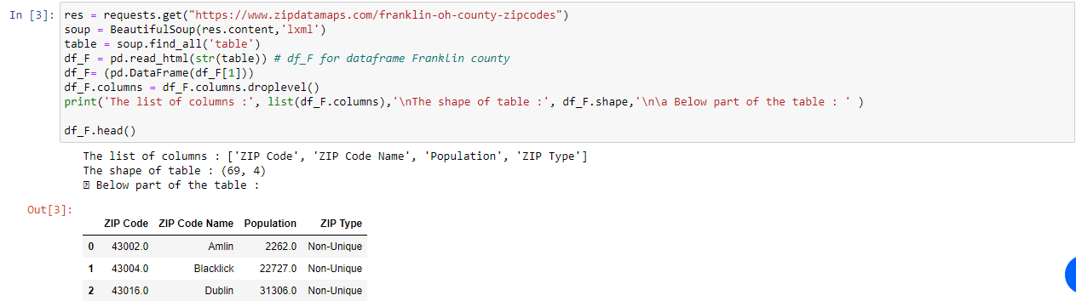
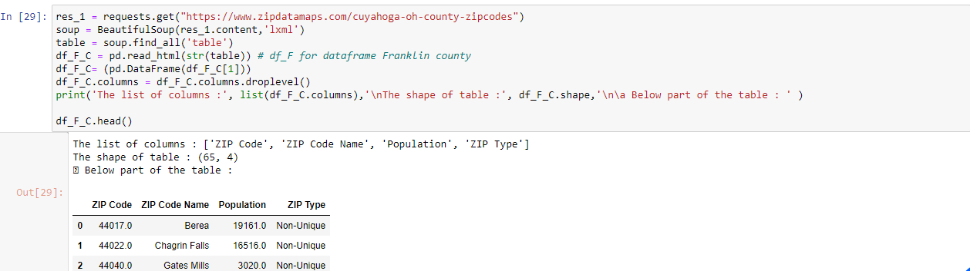
Import Data For Cites and Zip Codes in each county

Slide 8
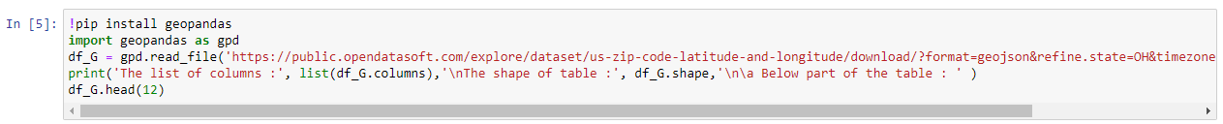
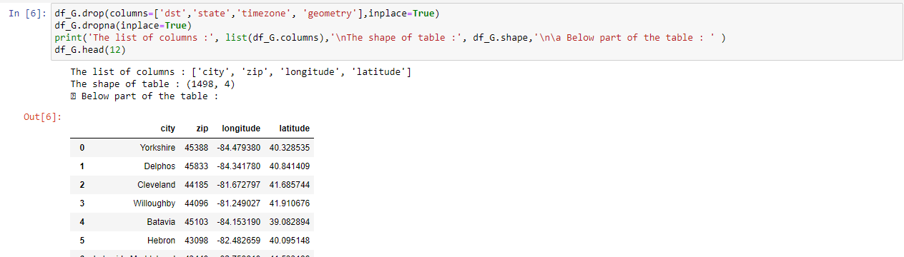
Import the Data for Cities in Ohio and Geo Coordination points

Slide 9
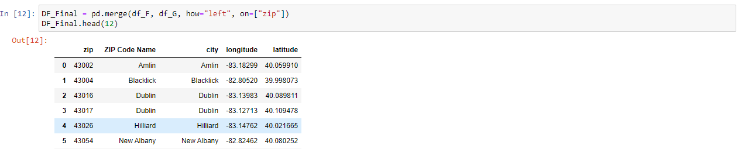
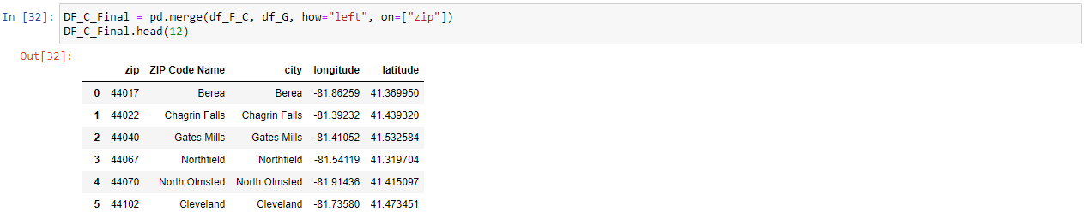
Clean tables and merge tables to get clean table for cities, Zip Codes and Geo Coordination for each county

Slide 10
Plot a map for each County

Slide 11
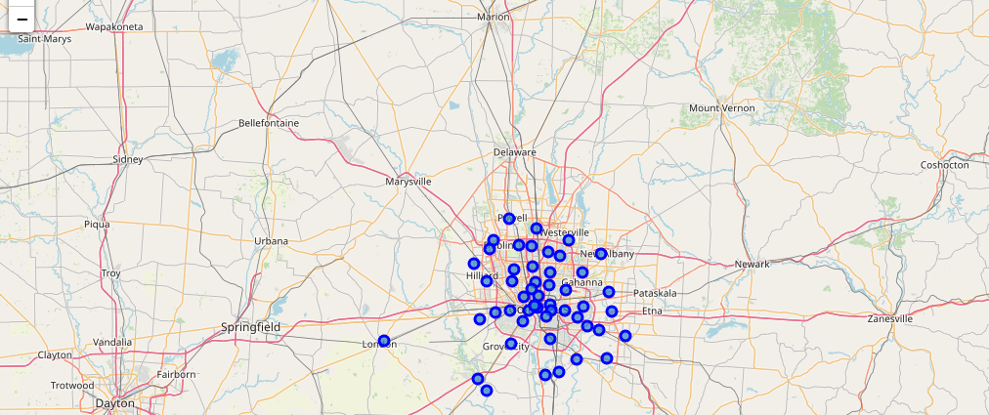
Franklin County

Slide 12
Cuyahoga County

Slide 13
Use Foursquare API to analyze the venues data
Important : We created a datafram with:
Three Venues for Franklin county ["Indian Restaurant", "Mediterranean Restaurant", "Turkish Restaurant"]
Two venues for Cuyahoga ["Indian Restaurant", "Mediterranean Restaurant"]
Why ?
Our study assume that theses venues are the venues highly depend on Halal products, so we focus on specific data.
We clean the data to be able to work on the data fram

Slide 14
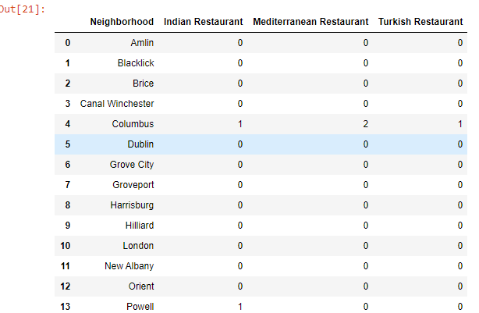
Sample of data for both Counties
Franklin County
Cuyahoga County

Slide 15
Apply Clustering in each data set and plot map

Slide 16
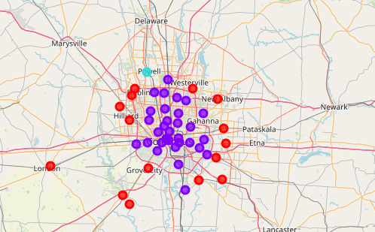
Franklin Cluster map

Slide 17
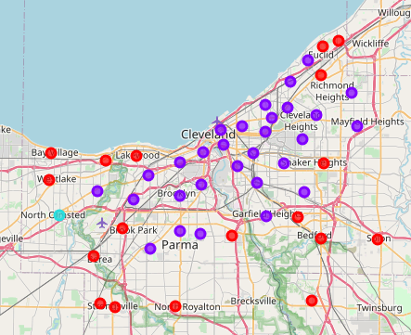
Cuyahoga Cluster map

Slide 18
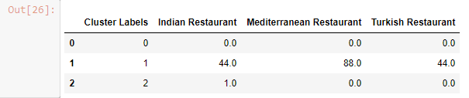
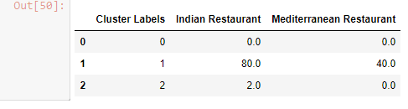
Find in each County which cluster has the most venues of (Indian, Mediterranean and Turkish
Franklin County : Cluster one has the highest Frequency of the specific venues
Cuyahoga County : Cluster one has the highest Frequency of the specific venues

Slide 19
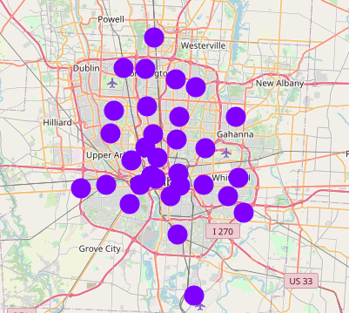
Franklin County – Cluster One

Slide 20
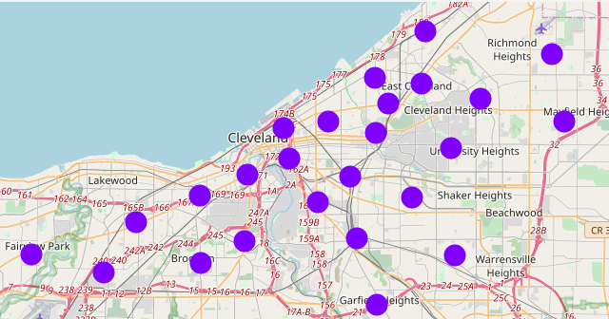
Cuyahoga county – Cluster one

Slide 21
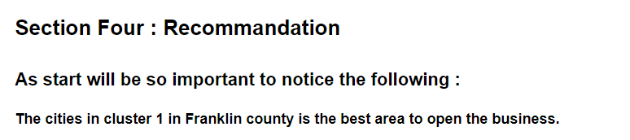
Conclusion:

